Slide 1
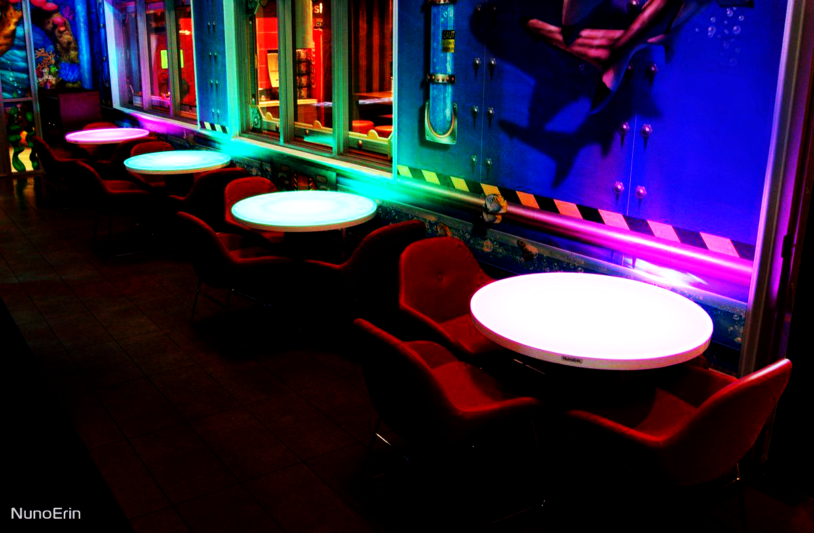
SMART TABLE
By Mishkat Haider Chowdhury Nikaela Balla Mauricio Guillermo Loza Arze

Slide 2
INTRODUCTION
The goal of our project is to introduce a new and efficient way for restaurants and coffee shops to serve their customers, which is implemented by a tangible interface.
The process of getting the waiter’s attention can be frustrating especially when you visit during a busy time of day. Our target audience is busy waiters and clients with limited social abilities.
Our project utilizes a cube-based interface that used LED lights and sensors specifically to tailor for client-waiter interactions.
Notes:
The goal of our project was to develop a modern user interface that deviates from the conventional WIMP metaphor. We set out to create a special and useful solution that not only functions as a real-world product that might one day be on the market but also adds a fun and fresh way for users to interact with it. With this in mind, we designed a SmartTable system that utilizes a cube-based interface that used LED lights and sensors specifically to tailor for client-waiter interactions in coffee shops or other food-based service facilities.
Central to our project is the emphasis on aiding individuals with disabilities by providing them with a visually intuitive means of communication with the waiter, while also simplifying the waiter’s tasks during busy periods. By inte- grating a cube-based interface, we offer a fresh and engaging method for clients to interact with the system and for waiters to streamline their operations during peak hours.
The intended users of our SmartTable system are both the waitstaff and the customers of the dining facility. By incorporating different modes and function- alities, such as requesting the waiter’s attention, asking for the bill, indicating a preference not to be disturbed, or marking the table as occupied, we ensure a seamless and intuitive interaction experience for clients. Similarly, waiters can use the system to set a table as reserved or turn off specific functionalities as needed, enhancing their workflow improving the workplace’s productivity To further enhance the user experience, our SmartTable system features an ultra- sonic sensor that accurately detects when a client is seated. This eliminates the need for manual communication or signaling, ensuring a more convenient and inclusive dining experience for individuals with disabilities.
In the sections that follow, we will provide a more detailed explanation of our SmartTable system’s design, requirements, technical aspects, and imple- mentation challenges. By prioritizing accessibility and user satisfaction, we aim to contribute to the advancement of human-computer interaction and create a more inclusive environment for both clients and waitstaff in food-based service establishments

Slide 3
REQUIREMENTS
Initial Functional Requirements
• The system should identify when a user is seated at the table.
• The system should provide an interface for both user types (client, waiter) to input commands and visually show confirmation of a command and state.
• Commands: occupied table, the client wants the attention of the waiter, the client does not want to get disturbed, client requests the bill, table reserved.
• For each of the commands the visual confirmation should use a different color.

Slide 4
Added Functional Requirements
The system should display a default color without receiving any command.
The system should have a gradual and not sudden change in color when receiving any of the recognized commands.
The system should through auditory means that the command was successful.
The system should shut down for a command outside of the cube interface. (when the waiter used a sticker not in the cube)
The system can tell when a client is sitting for the first time, and the state switches to requesting waiter.

Slide 5
Initial Environmental Requirements
• The system’s visual indicators should be visible in a variety of lighting conditions.
• The system’s visual indicators should be visible no matter the position of the table.
• The system should not interfere with the intended use of the table.
• The system should withstand incidents common to restaurant tables.

Slide 6
Added Environmental Requirements
• The system should have auditory indicators that alert but do not disturb the client.
• The system should not have more than 10 seconds of delay to respond to commands.
User Characteristics
• Client: The expected skill set of the client is a novice and he is supposed to intuitively understand how to use the device through the visual stickers we have provided.
• Waiter: The expected skill set of the waiter is expert, as he has training with device.

Slide 7
Usability Goals
• Learnability: The user can work out how to use the interface intuitively and by seeing the stickers.
• Safety: The waiter can use an outside command (sticker) to turn off the system.
• Efficiency: Once a user has input a command, the system must be 100% correctly responsive.
User Experience Goals
Using the command interface should be an enjoyable experience.
The system engages with the user through a tangible user interface.

Slide 8
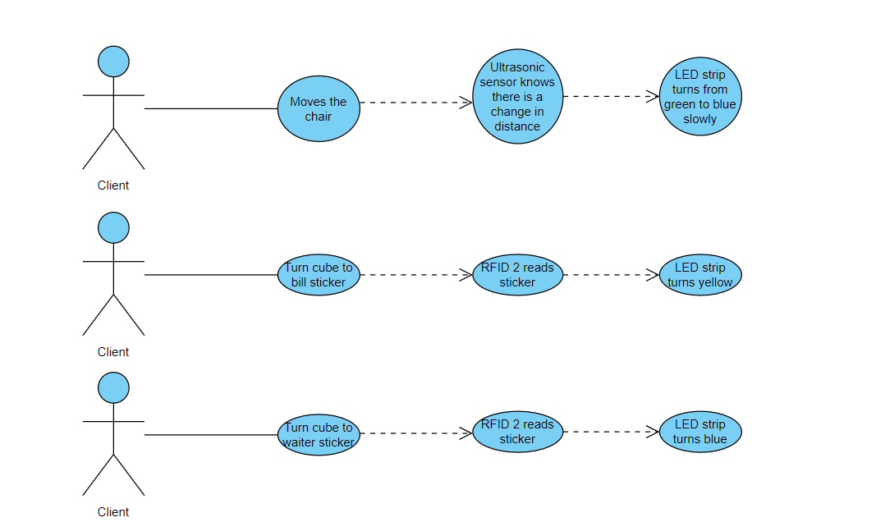
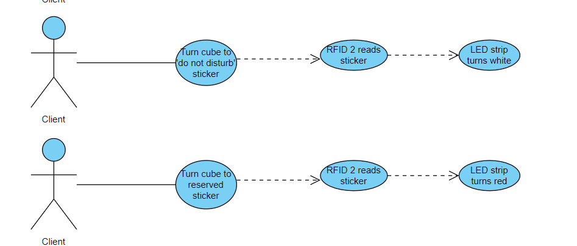
Use Cases
The different use cases for the client

Slide 9
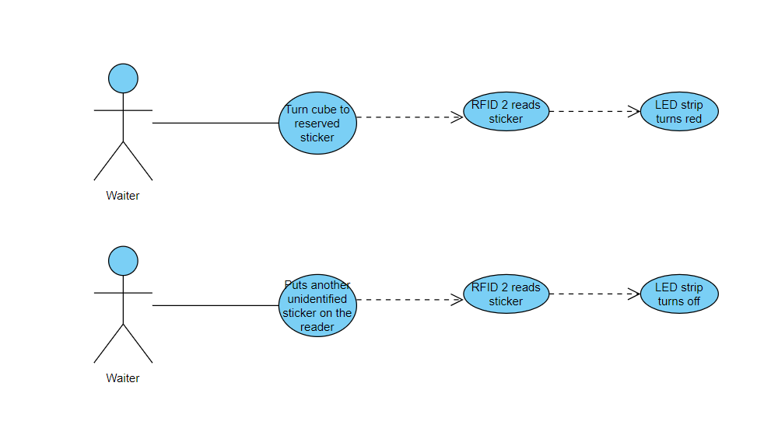
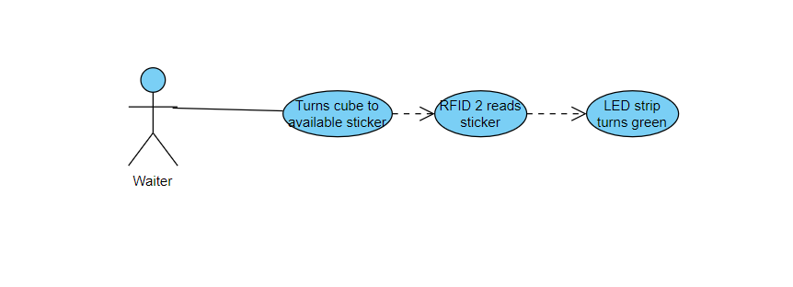
Use Cases
The different use cases for the waiter

Slide 10
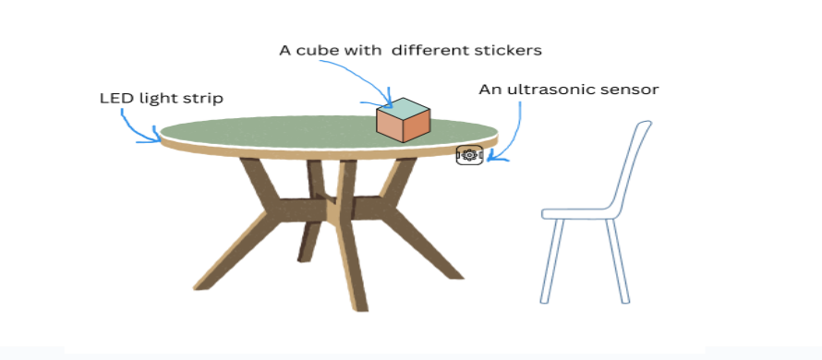
Design of the SmartTable
Notes:
Here we have a simple diagram of the table design, pointing out the different components.
The distance sensor under the table.
The led strip around the table.
The cube over the table the change statuses

Slide 11
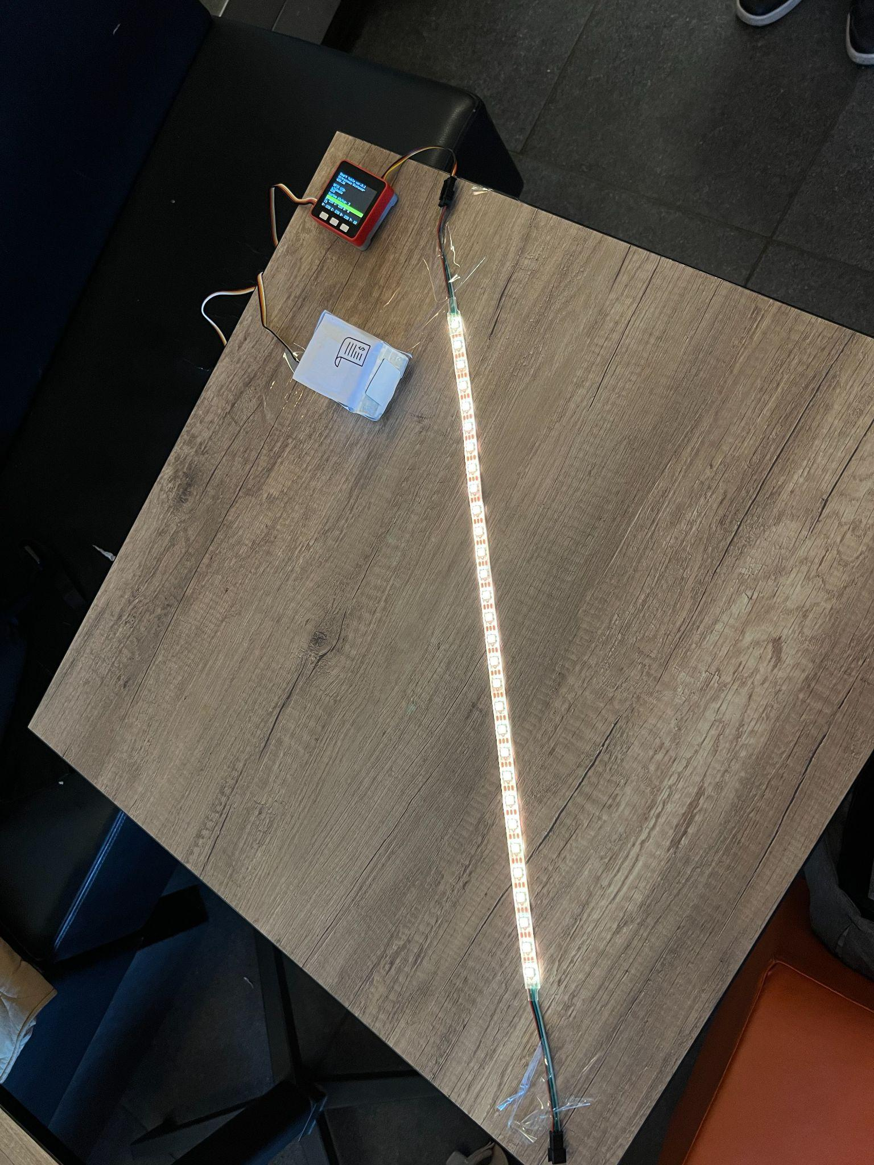
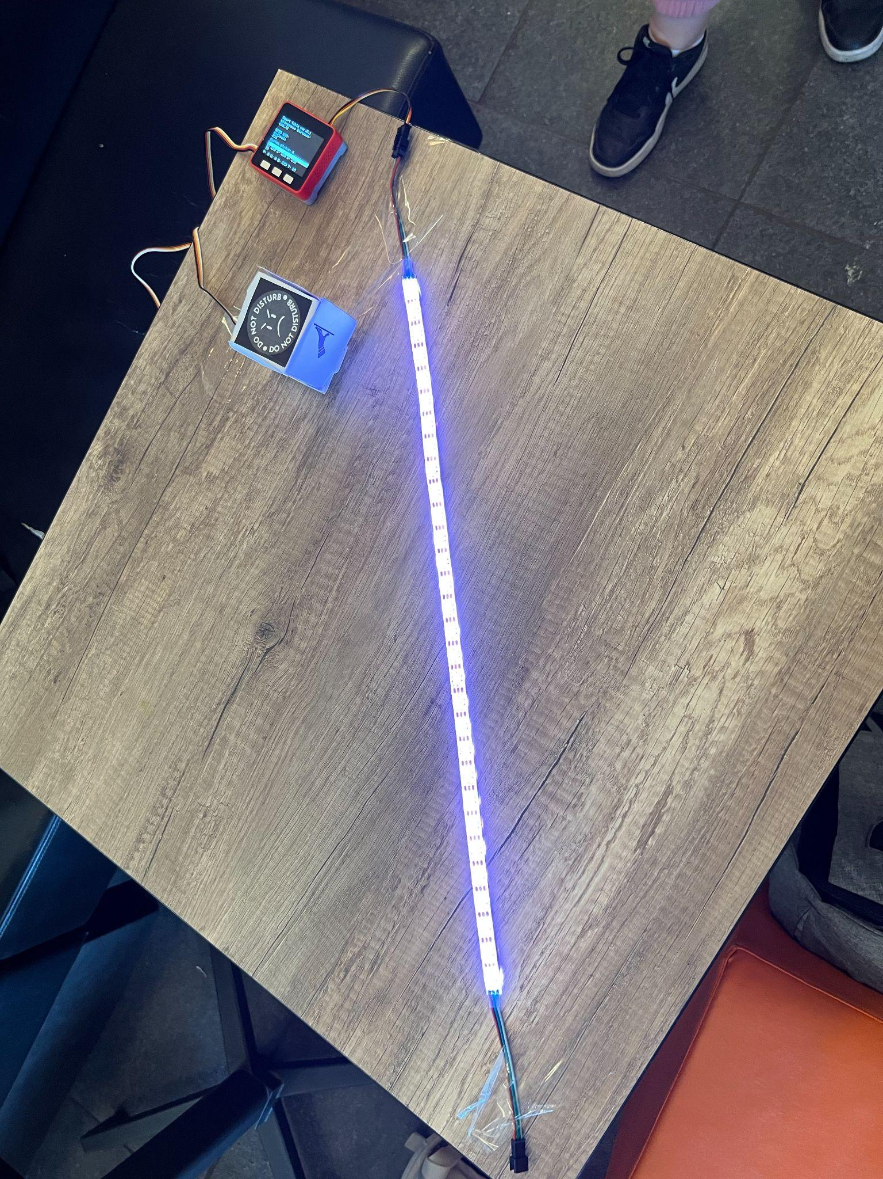
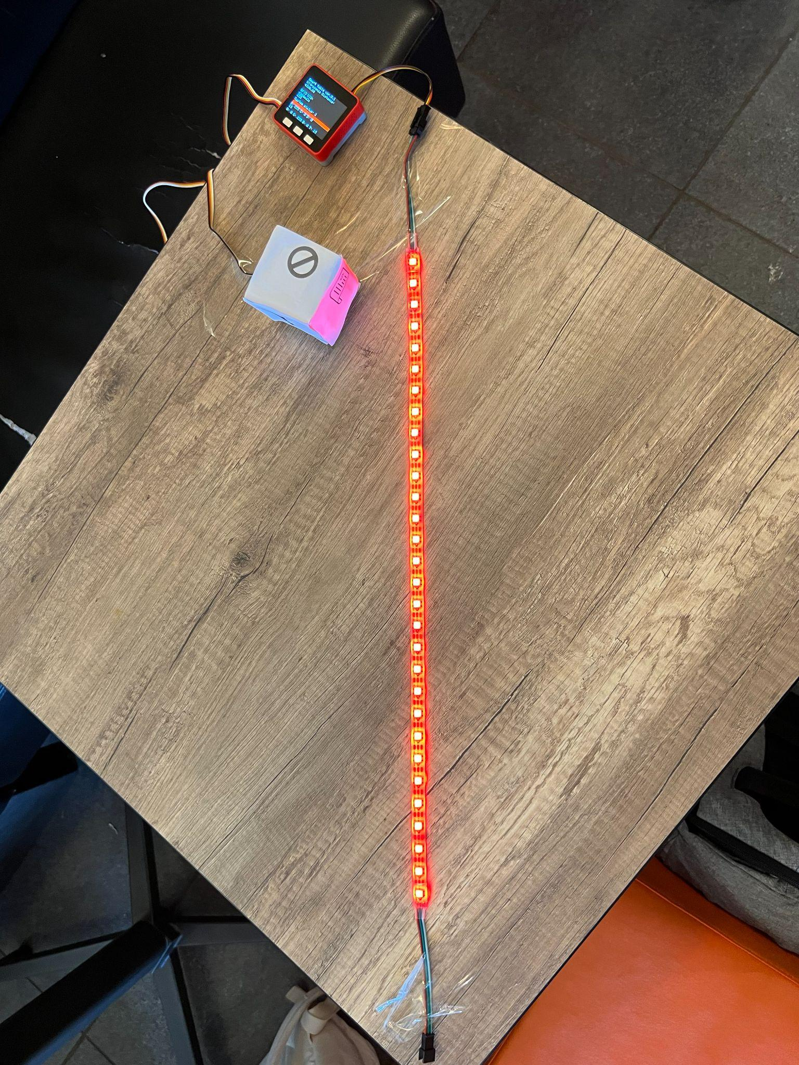
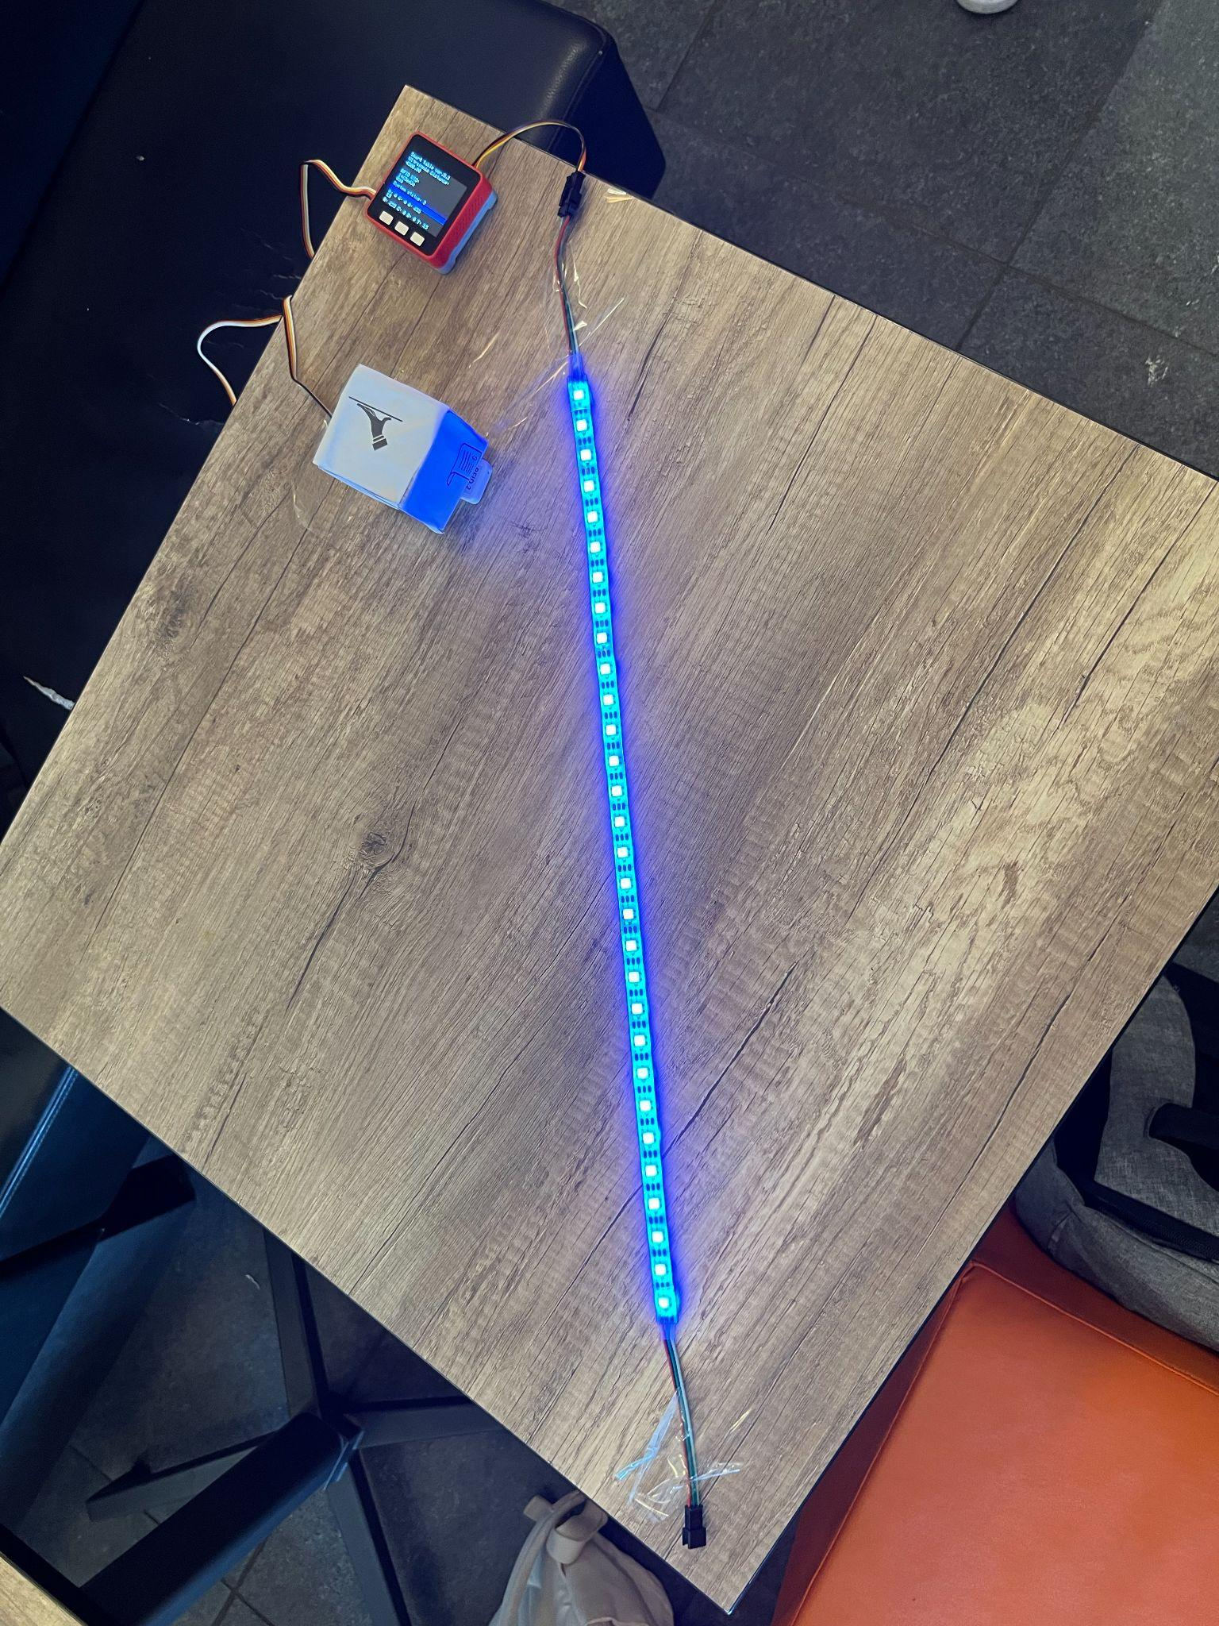
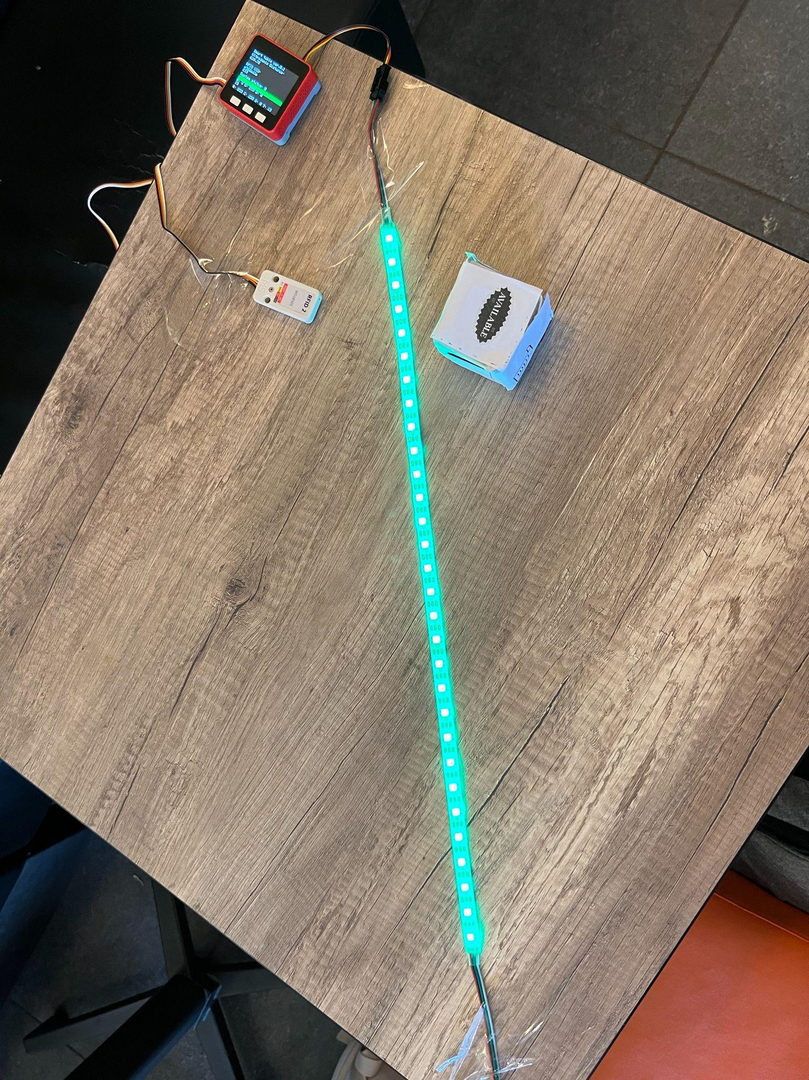
Different Colours with Different Functionalities
Bill Please
Do Not Disturb
Reserved
Waiter Please
Available
Notes:
Here we have a representation of the table for demonstration purposes. For each one of the statuses defined previously outlined

Slide 12
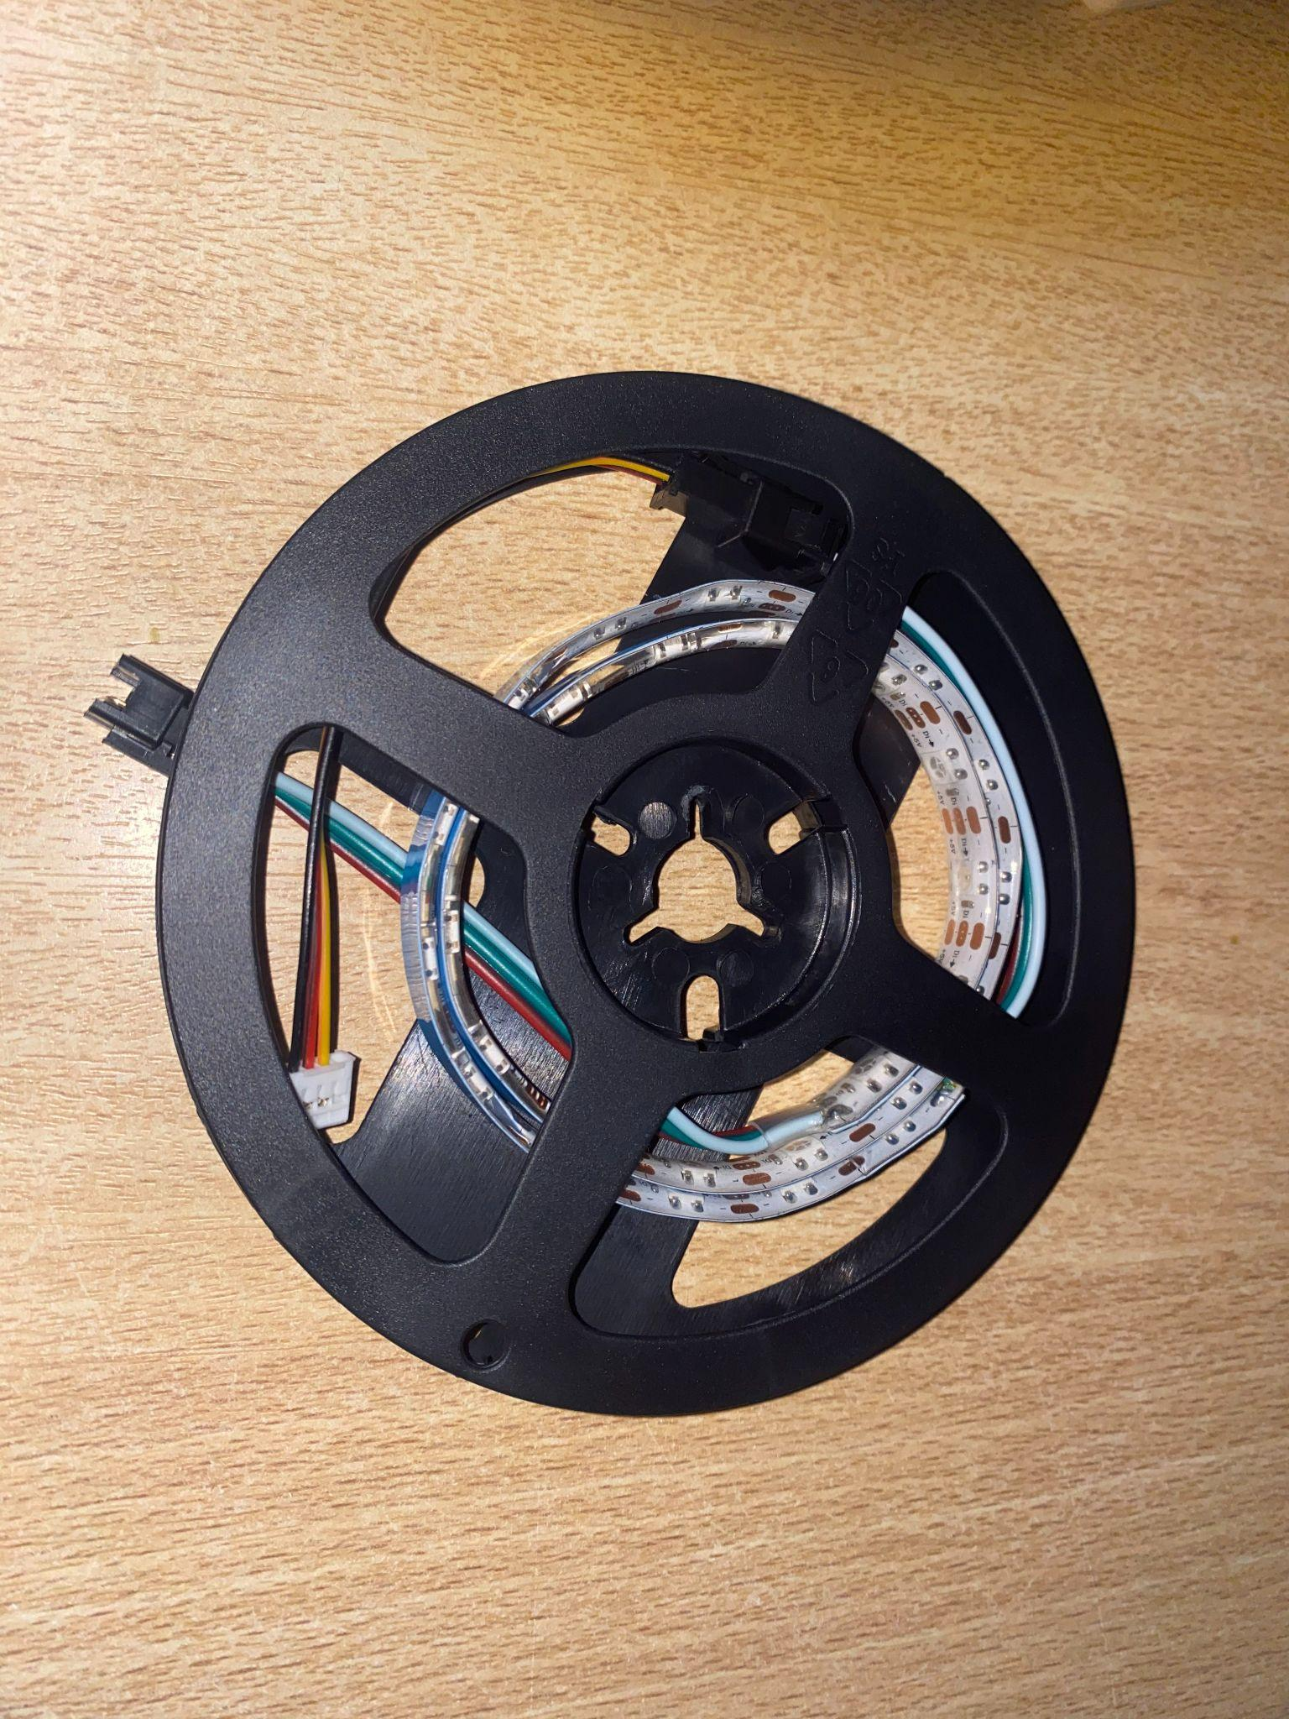
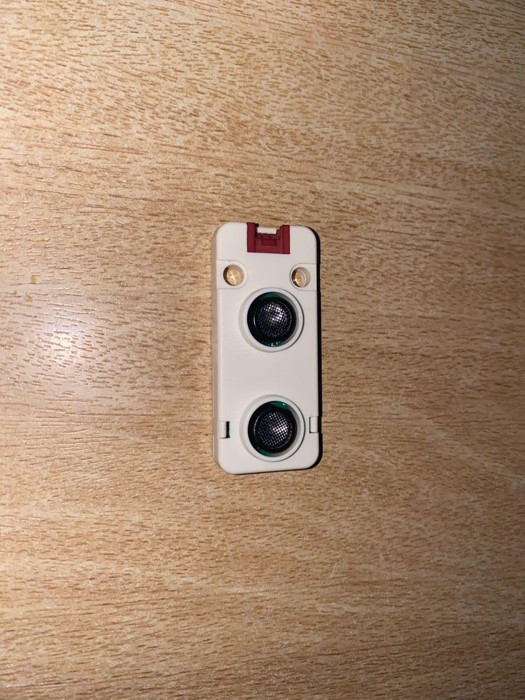
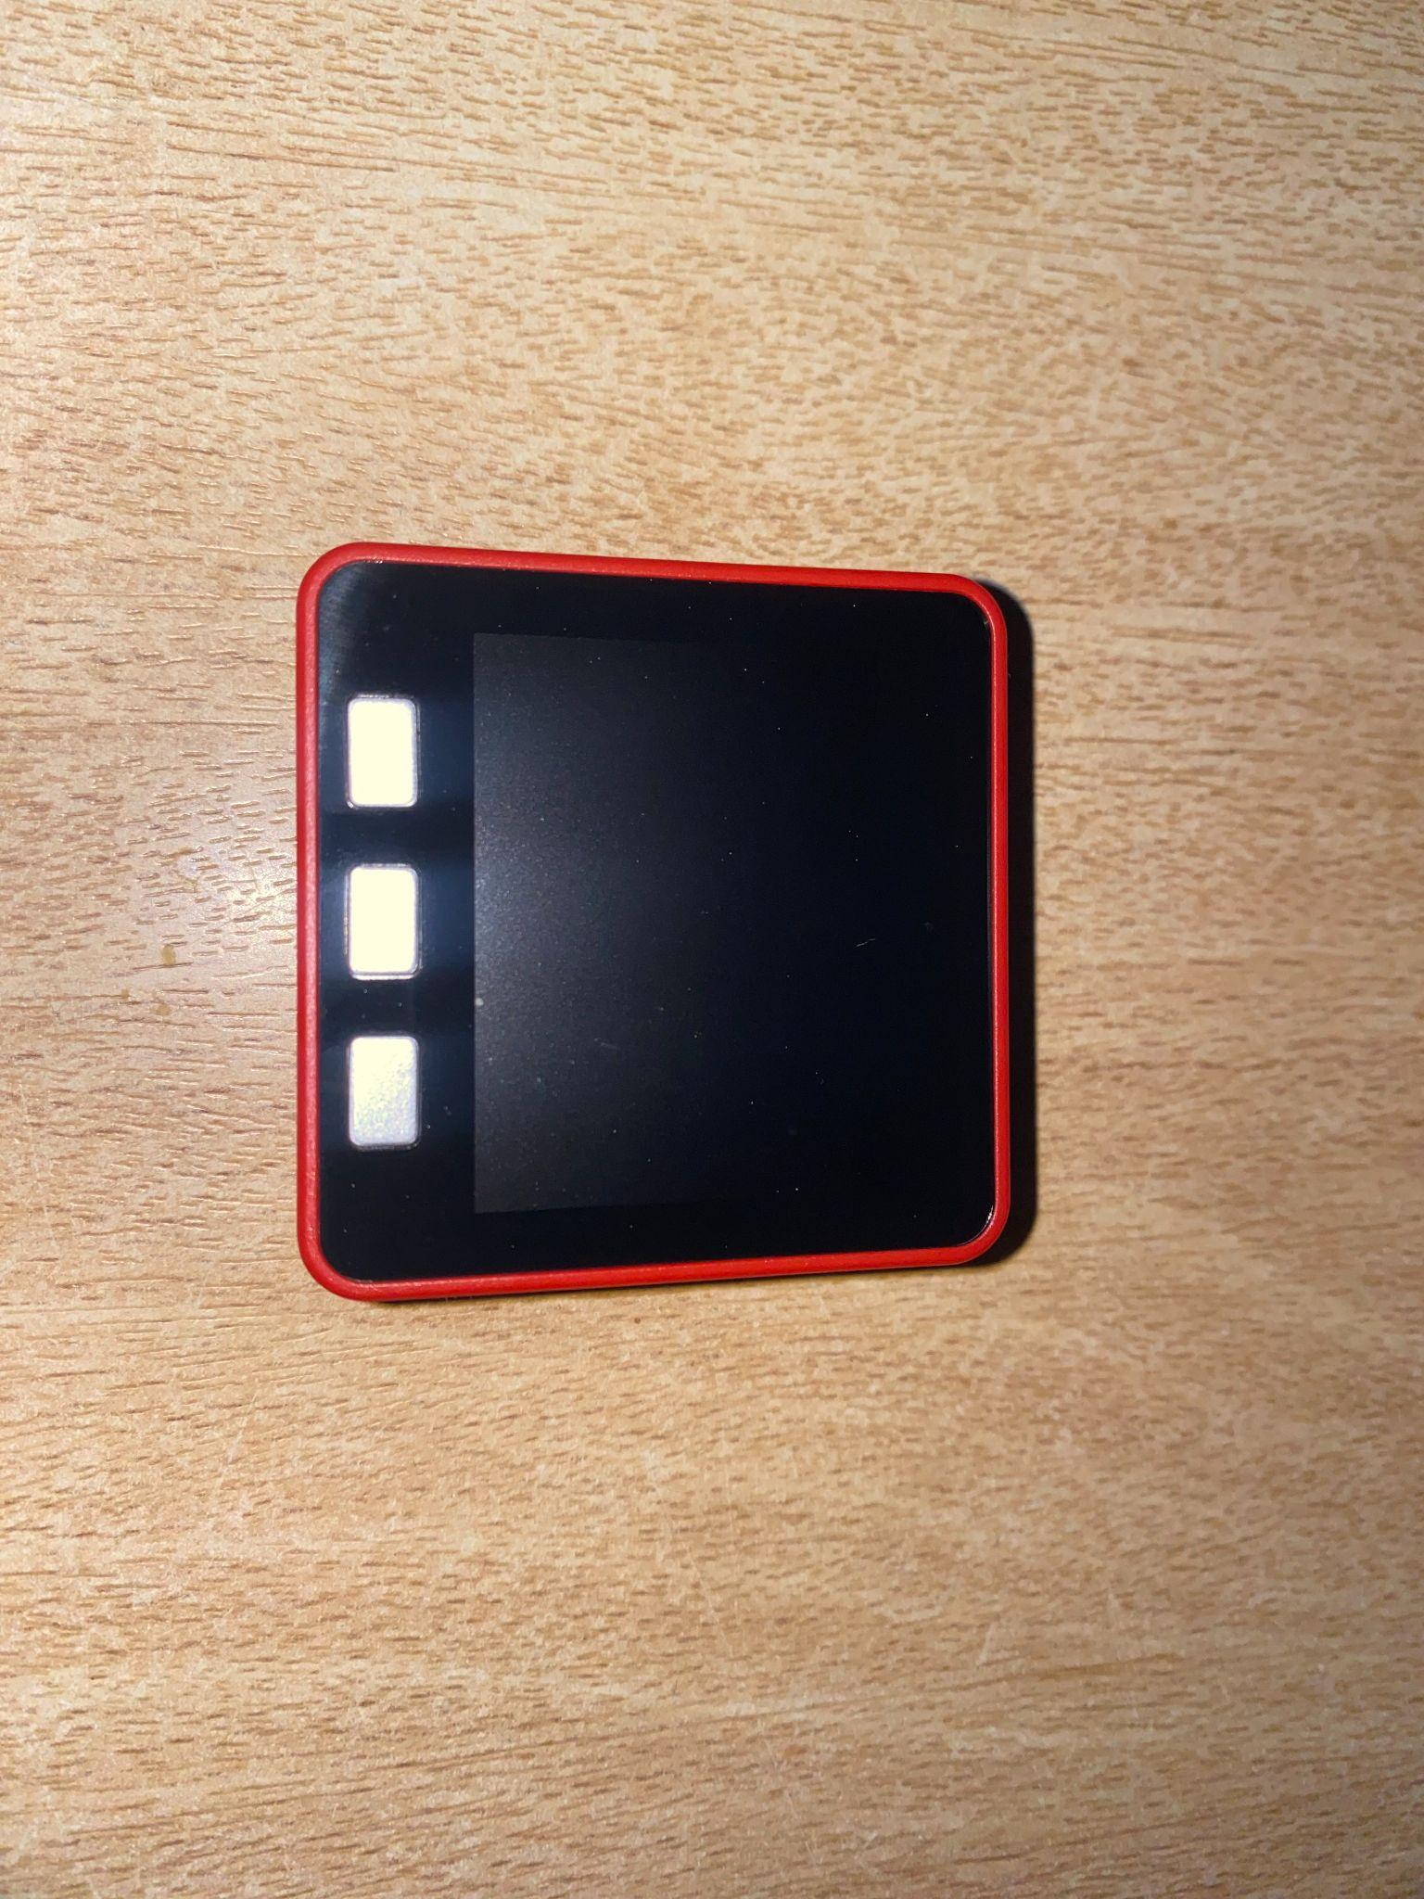
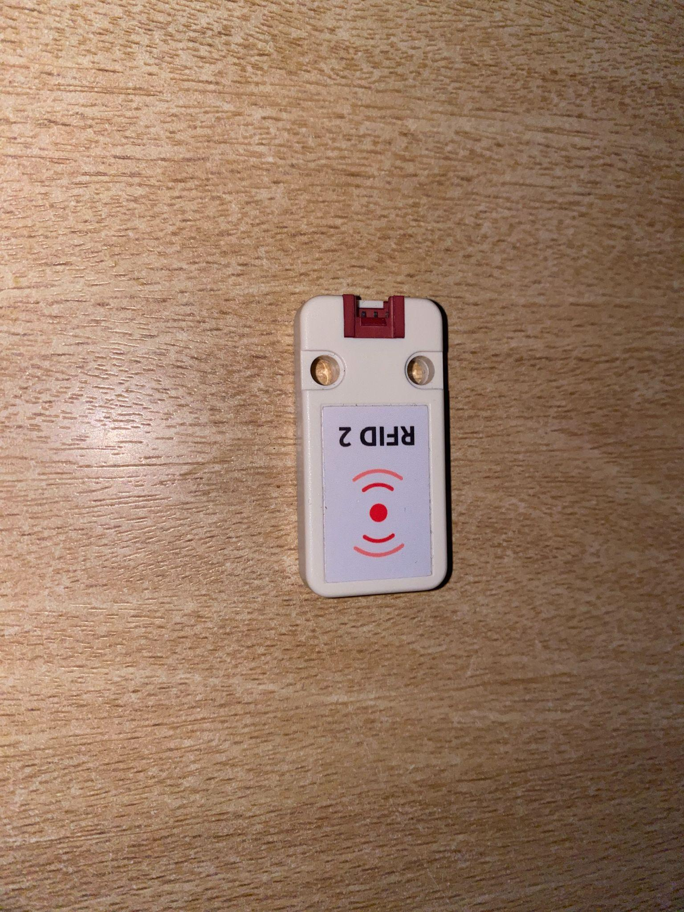
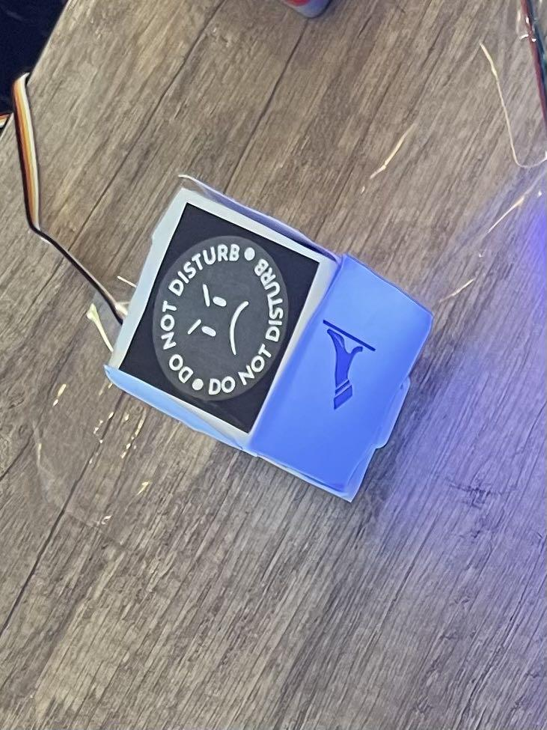
Technical Implementations
Hardware
LED Strip
Ultrasonic Distance Unit
FIRE M5STACK
RFID
RFID Stickers on a Carton Cube

Slide 13
Architecture
Arduino-based system: Utilizes C++ programming language and M5Stack devices.
Default sketch structure: Includes setup and loop functions. Setup function: Initiates sensors, LED strip, and speaker.
Loop function: Contains main program logic.
RFID reader: Detects new tags, stores UID, and assigns corresponding system status code.
Ultrasonic sensor: Monitors distance and triggers status code change after ten consecutive readings with distance over 800mm.
LED color update: Changes based on status code, with different color transition steps.
Beep confirmation: Short beep from the device speaker confirms status code change.
Color transition: Continues until target color is reached. Loop restarts: For new possible events and status changes.
Notes:
The code used as base the corresponding examples for each device in the M5Stack GitHub repository.
The device runs with the default sketch structure of Arduino using C++. There are two main functions that every Arduino program has: the setup and the loop. In the setup the sensors are initiated alongside the setup for the LED strip and the speaker in the device. In the loop is where the main logic of the program resides.
The system work as follows inside the loop function:
- The system checks if there change in the corresponding sensors:
RFID reader: when there is a new tag detected, the UID of it is stored in a string. With the UID the system can select the new system status code depending on the value. These are in an array with the code being their position in it (going from cero to four, each for one of the statuses on the cube) and a fallback status for unregistered UID’s (number nine).
Ultrasonic sensor: In the case of the ultrasonic sensor there need to be a total of ten consecutive reads with a threshold distance superior to 800 mm (and system status equal to zero) then the status code would become five.
- If the status changes it means that the LED colors need to update as well. In this case the target color and color transition steps are defined depending on the status code. For statuses zero to four and nine use the short transition with 25 steps (three seconds) and the long transition with 300 steps (one minute) for status code five.
- If the status changes a short beep would come from the device speaker to confirm the change.
- The color transition would continue until the target has been reached.
- The loop restart for new possible events.

Slide 14
Challenges
M5Stack Core2 experienced signal interference when using all three ports, so there was a switch to M5Stack FIRE.
Ultrasonic sensor were not reliable, as they had difficulty calculating distance accurately, so LED lights were modified to change color only when there is a change in the initial distance.
LED Lights transition from green to blue only the first time the client sits down (to request waiter). This approach eliminates the need for frequent color changes when the client moves.
Notes:
While initially we choose to use a M5Stack Core2, there was signal interference when we used all three ports. So with the suggestion of the teacher assistant, we switched to FIRE, through which we had no problems. The ultrasonic sensor had some trouble calculating the distance and was not always accurate. Even- tually, we decided to make the LED lights change when it sensed a change in the initial distance. Therefore the lights turn from green to blue only the first time the client sits down. This will be better as there is no need for a change anytime the client moves.

Slide 15
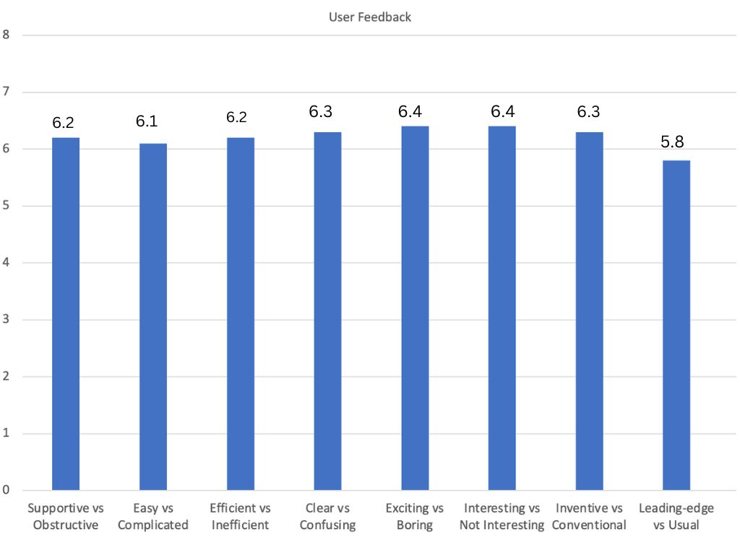
Evaluation
Notes:
For the user feedback, we presented our project to 10 users. One of them was the waiter in the ”Opinio” cafe, who has years of experience and the other nine were random people who have been clients in dining establishments before. After displaying the project we gave them a form to evaluate our project where we asked them several questions about their experiance with the project and if they had any remarks.
In our questionnaire, we instructed them to indicate their level of agreement or disagreement based on a Likert scale which ranges from 1 to 7. On this scale, 7 indicates a strong positive response whereas 1 represents a strong negative response.
We have displayed the average of all the responses from the users in the graph below: In the graph, ”supportive”, ”easy”, ”efficient”, ”clear”, ”exciting”, ”interesting” and ”leading-edge” refers to the positive attributes. On the other hand ”obstructive”, ”complicated”, ”inefficient”, ”confusing”, ”boring”, ”not interesting”, ”conventional”, and ”usual” refers to negative attributes. These negative attributes highlight limitations.
We have calculated the average of all the feedback we got from different users and put it on the bar chart. As we can see most users find the product exciting and interesting but not really as cutting-edge.

Slide 16
Insights from the Waiter User
The product addresses an actual need in the market, as there is not much innovation in this kind of field, which is more focused in the quality of food and visuals. It is also quite fun to use. But there are some things we could add to make it a more useful product:
Adding a dashboard that displays all the tables and their current color.
Integrating a whole network of tables on a central hub for the staff

Slide 17
Insights for Improvement from Users’ Perspective
Other than rating through the Likert scale, the users also gave a few feedbacks both positive and negative that can be improved. Some of the major points are stated:
It would be useful for the cube to be integrated into the table.
Not all the stickers give a clear idea on what mode to use the cube for.

Slide 18
Performance Metrics
1. Response Time: average of 7 seconds for the ultrasonic sensor to calculate distance.
2. LED Lights Responsiveness:The system detects the command right away, but it takes on average 9 seconds for the color to fully change.
3. Consistency of LED Lights: The lights are 100% consistent.
4. Sound Indicator Accuracy: The sound is 100% consistent.
All evaluation were run 20 times.

Slide 19
Limitations
The ultrasonic sensor has some reliability issues.
The system can only detect one person sitting at a time.
The lack of water resistance is a drawback for a device used in dining and drinking establishments.
Notes:
There are some limitations to our project. The ultrasonic sensor is not very reliable, as it takes some time for it to understand there is a change in distance, and therefore to alert the system. As there is only one sensor, it can only tell if one person is sitting, and they need to be sitting in the position where the sensor it. LED lights changing is a bit slow, we believe this is better so as to not disturb the client’s eye. But some clients may not like having to wait. The fact that the product is not water resistant in not ideal for a device used in dining and drinking establishments.
There are also some things we would like to improve upon in future imple- mentations. The material of the cube would be wood and the stickers would not be paper but plastic. This would make the cube less delicate as well as more ascetically pleasing. As mentioned in the limitations part, We would like to find a way to make the device water-resistant. The ultrasonic sensor would also need to be replaced. The product uses wires to make connections, in the future, we would like to implement something seamless. Right now the cube is placed on top of the RFID sticker, in the future we would like for there to be a set station for the cube.

Slide 20
Future Work
We would use durable materials, such as wood for the cube and plastic for the stickers.
Explore options for making the device water-resistant to ensure its suitability for use in various environments.
Replace the current ultrasonic sensor with a more efficient and reliable alternative.
Investigate the possibility of implementing wireless connections to create a more seamless user experience.
Create a dedicated station or holder for the cube to provide a more organized and structured setup.
Notes:
There are some limitations to our project. The ultrasonic sensor is not very reliable, as it takes some time for it to understand there is a change in distance, and therefore to alert the system. As there is only one sensor, it can only tell if one person is sitting, and they need to be sitting in the position where the sensor it. LED lights changing is a bit slow, we believe this is better so as to not disturb the client’s eye. But some clients may not like having to wait. The fact that the product is not water resistant in not ideal for a device used in dining and drinking establishments.
There are also some things we would like to improve upon in future imple- mentations. The material of the cube would be wood and the stickers would not be paper but plastic. This would make the cube less delicate as well as more ascetically pleasing. As mentioned in the limitations part, We would like to find a way to make the device water-resistant. The ultrasonic sensor would also need to be replaced. The product uses wires to make connections, in the future, we would like to implement something seamless. Right now the cube is placed on top of the RFID sticker, in the future we would like for there to be a set station for the cube.

Slide 21
Conclusion
SmartTable project: New and creative user interface.
Cube-based interface: Supported by ultrasonic sensors, LED lights, and NFC card readers.
Easy experience: Designed for coffee shops and restaurants.
Positive user feedback: Gathered through forms, testers found the product supportive and interesting.
Limitations and shortcomings: Acknowledged, but overall showcases innovation.
Improving the dining experience: Key objective of the SmartTable project.

